Slide 1
Status a2energy
May 14, 2012

Slide 2
a2energy program
An outreach and education effort that aims to promote energy efficiency and
the use of renewable resources
to residents and businesses
across the
City of Ann Arbor

Slide 3
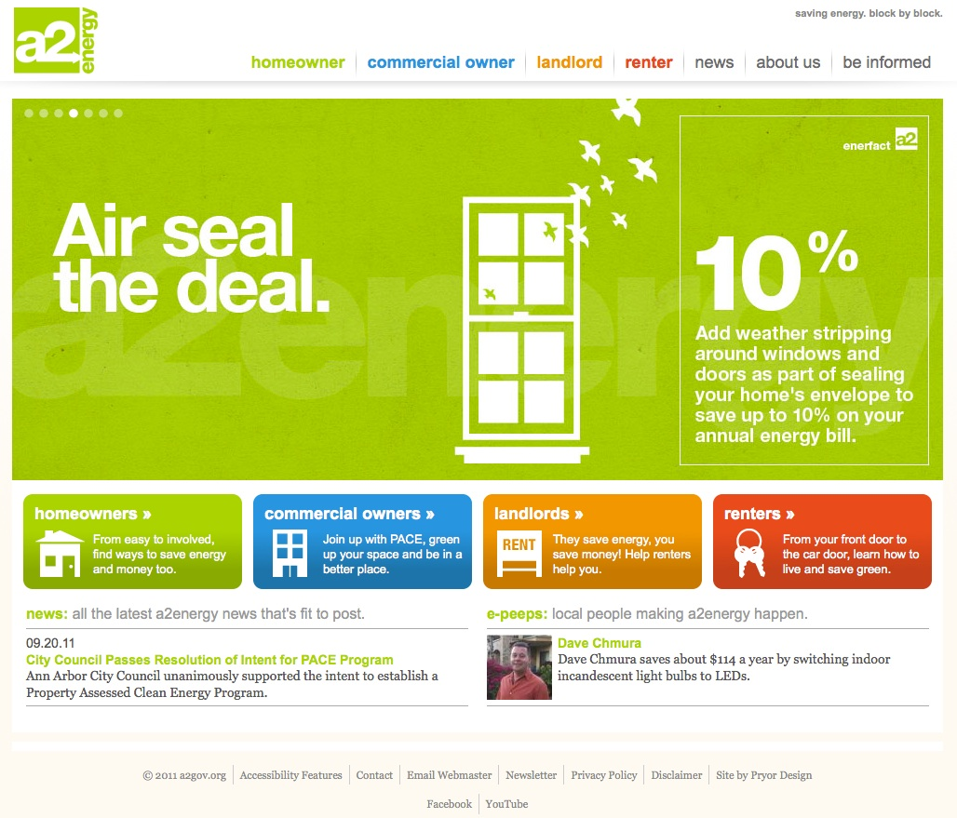
a2energy.org

Slide 4
a2energy.org statistics
Nearly 1,000 visitors since the site launched in early Feb
Average site visit lasts nearly 4 minutes
Relatively low “bounce rate”
  Visitors going beyond the home page
See spikes in visits after promotional events
  press release, media coverage, Earth Day participation
6 e-peeps featured on site, more in process

Slide 5

Program outreach
Promoting website and program “brand”
Practical, not wasteful, materials
Public presence
  Earth Day booth
  Mayor’s Green Fair booth
  Mission Zero Fest

Slide 6

a2energy Contractor Partners
Kickoff event Feb 16th - nearly 40 companies
Application process:
  MI Saves authorization, signed agreement with City, insurance coverage for City
8 partners confirmed, 4 applications pending

Slide 7
Status
Ann Arbor City Council
May 14, 2012
Wendy Barrott
PACE Program Administrator

Slide 8
Ann Arbor energy goals
First Energy Plan – 1981
Mayor’s Green Energy Challenge
  2015 goals
    Municipal
      reduce greenhouse gas emissions 50% below 2000 levels by 2015
      30% renewable energy
    Community
      reduce greenhouse gas emissions 8% below 2000 levels by 2015
      5% renewable energy

Slide 9
Ann Arbor community GHG emissions - 2010

Slide 10
PACE in Michigan
Established by PA 270 in 2010 - allows local governments to establish energy financing districts
Commercial and industrial properties eligible
  not residential due to FHFA letter
Financing for energy efficiency improvements and renewable energy systems
NOT a general obligation of local government
Requires mortgage holder consent
Sets assurances to protect eligibility, feasibility

Slide 11
Why PACE?
Provides attractive financing – not offered by other sources
Low, fixed interest rates
Long repayment terms
May transfer with property
Security to investors
  repayment structured to be less than energy savings achieved by project
  lien provides City ability to collect equal to property tax collection
  loan loss reserve

Slide 12
Projects serve a public purpose
spurs economic development
creates jobs
increases property values
reduces energy use
controls
energy costs
reduces greenhouse gas emissions

Slide 13
Energy savings through PACE

Slide 14
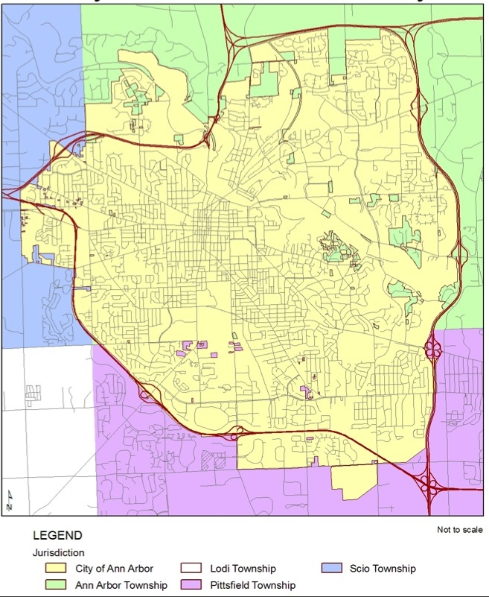
Ann Arbor’s Energy Financing District

Slide 15
Who is eligible?
Commercial properties
  property subject to Michigan Building Code
  includes
    apartment buildings with 3 or more units
    tax exempt -- churches, private schools
    retail, offices, manufacturing
    all properties except those subject to Michigan Residential Building Code
      single family, duplex, certain townhouses (and public schools)

Slide 16
What is eligible?
energy analysis (energy audit)
insulation & weather sealing
lighting & controls
solar thermal hot water*
high-efficiency shower & faucet aerator replacements
ENERGY STAR appliances
wind turbines*
new doors & windows
combined heat & power systems
ground source heat pumps
solar photovoltaic (electric) systems*
biomass thermal systems
heating, ventilation and air-conditioning (HVAC) upgrades
    *Energy efficiency must be improved before implementing renewable energy systems

Slide 17
Overview of project process
Pre-application
Application
Review
Installation
Tracking
1.
2.
3.
4.
5.

Slide 18
Integration into Ann Arbor processes
Use of existing assessment billing system
Special module for incorporation intoTRACKiT
Coordination with building inspections
Coordination with City’s payment process
Coordination with lien process
  consistent with City & County

Slide 19
Thank you!
Financial Services Area
City Service Units
Treasury Division Unit
IT
Systems Planning Unit
City Attorney’s Office

Slide 20
Status
PACE Training March 8th
Presentations
  Washtenaw Area Contractor Association
  Washtenaw Apartment Association
  BOMA
  WasteKnot
  Ann Arbor AIA Chapter
One-on-one meetings – 32
Phone inquiries - numerous

Slide 21
Status
Seven pre-qualified auditors
Number of pre-screenings
24
Number of applications received
0

Slide 22
Status
Number of applications and size estimated coming – date coming
4 totaling $700,000 – week of May 14th
1 totaling $14,000 – week of May 14th
1 totaling $60,000 – week of May 14th

Slide 23
Status
Number of new audits underway
  7 – 8 large property manager (one every 2 weeks)
  2 buildings at office complex
Number of seriously interested
  10

Slide 24
Summary
Businesses are interested
Favorably received
Slow to ramp up
  New program
  New concept
    use operating money instead of their capital
    concerns about the lien
  Time needed by applicant to scope project and apply competes with other priorities
    true for any energy efficiency projects

Slide 25
PACE Program Administrator
Wendy Barrott
pace@a2gov.org
734.794.6430 x43714

